Slide 1
TRAVEL AND TOURISM
UNDER THE GUIDANCE OF:
Dr. M. Chaitanya Kishore Reddy.
Team Members:
V. Rohit (19KN1A1256)
V. Sirisha (19KN1A1257)
U. Sai Syam (19KN1A1254)

Slide 2
TOPICS:
Abstract
Literature Survey / Existing System
Proposed System
Procedure
Hardware and Software Requirements
Languages
System Architecture
Screens
Conclusion

Slide 3
aBSTRACT
This project “TRAVEL AND TOURISM” is used to automate all process of the travel and tourism, which deals with creation, booking and confirmation and user details. The project is designed HTML-PHP as front end and Microsoft SQL Server 2008 as backend which works in any browsers. The coding language used HTML and PHP. Travel and tourism management system is used to book a tour from anywhere in the world by a single dynamic website which will help the user to know all about the places and tour details in a single website. The admin can add packages to the website from a certain travel agents and hotels by create a tour page. Then the users can sign in and book each project, they can be confirmed by the admin in them manage booking page. The user can see the confirmation in my booking page. It is an easiest platform for all travelers which can be easily booked and know the all details.

Slide 4
LITERATURE SURVEY / EXISTING SYSTEM
In the existing system, each task is carried out manually and processing is also a tedious job. In previous system travellers were maintaining time table details manually in pen and paper, which was time taking and costly. The travellers are able to achieve its need in time and also the results may not accurate. Because of the manual maintenance there are number of difficulties and drawbacks exist in the system.

Slide 5
Drawbacks of the Existing System:
Increased transaction leads to increased source document and hence maintenance becomes difficult.
If any admin, user enter wrongly made then the maintenance becomes very difficult.
If any user forgets his registration number, then it is very difficult to maintain it by admin.

Slide 6
PROPOSED SYSTEM
The proposed system is designed to be more efficient than the manual system. It invokes all base tasks that are now carried out manually, such as the forms transactions and reports which is added advantage. The proposed System is completely computer-based application. Thousands of records can search and displayed without taking any significant time

Slide 7
Advantages of the Proposed System:
Gives accurate information
Simplifies the manual work
It minimizes the documentation related work
Provides up to date information
Friendly Environment by providing warning messages.
Traveller’s details can be provided ∙
Booking confirmation notification

Slide 8
PROCEDURE
User Management :
Login
User Profile
Update Information
Role Based Rights
Transportation Module :
Flight
Train
Bus

Slide 9
Package Module:
User can view different tour packages available for tourist. User can select any packages from this module he can also check the details of various travel agencies. A user can select any travel agency from this module.
Payment Modules:
Payment through PayPal, Remit2India etc.
Search Module:
Search City wise hotels, Flights, Packages, Bus and Railways

Slide 10
Hardware and software requirements
Recommended Operating Systems:
Windows: 7 or newer
MAC: OS X v10.7 or higher
Linux: Ubuntu

Slide 11
HARDWARE REQUIREMENTS:
Processor: Minimum 1 GHz; Recommended 2GHz or more
Ethernet connection (LAN) OR a wireless adapter (Wi-Fi)
Hard Drive: Minimum 32 GB; Recommended 64 GB or more
Memory (RAM): Minimum 1 GB; Recommended 4 GB or above
Sound card w/speakers
Some classes require a camera and microphone

Slide 12
SOFTWARE REQUIREMENTS:
Operating System:
Windows7 An Operating System (OS) is an interface between a computer user and computer hardware.
Functions of an operating system:
➢ Memory Management
➢ Processor Management
➢ Device Management
➢ File Management
➢Security
➢ Control over system performance
➢ Job accounting
➢ Error detecting aids
➢ Coordination between other software and users 11

Slide 13
Languages Identified
HTML :
HTML is the standard markup language for creating Web pages. HTML stands for Hyper Text Markup Language
➢ HTML describes the structure of a Web page.
➢ HTML consists of a series of elements.
➢ HTML elements tell the browser how to display the content
➢ HTML elements are represented by tags
➢ HTML files are saved using .html extension
➢ HTML tags label pieces of content such as "heading", "paragraph", "table", and so on

Slide 14
CSS:
CSS stands for Cascading Style Sheets.
CSS is a style sheet language used for describing the presentation of a Webpage
CSS provides more flexibility and control in the specification of presentation.
CSS enables multiple webpages to share formatting.
CSS files are saved using .CSS extension.
CSS provides Site-wide consistency
PHP:
PHP stands for Hypertext Pre-processor.
PHP is server scripting language.
At Present we are using PHP 7
PHP 8 is in beta
PHP files are saved using .php extension

Slide 15
SQL:
SQL is a standard language for storing, manipulating and retrieving data in databases.
Allows users to access data in the relational database management systems.
Allows users to describe the data.
Allows users to define the data in a database and manipulate that data.
Allows to embed within other languages using SQL modules, libraries & pre-compilers.
Allows users to create and drop databases and tables.
Allows users to create view, stored procedure, functions in a database.
Allows users to set permissions on tables, procedures and views

Slide 16
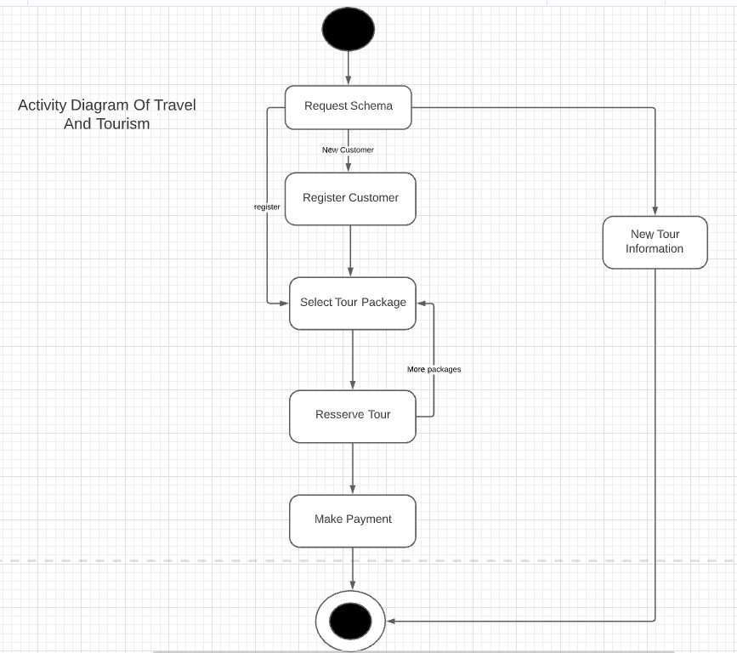
System Architecture

Slide 17
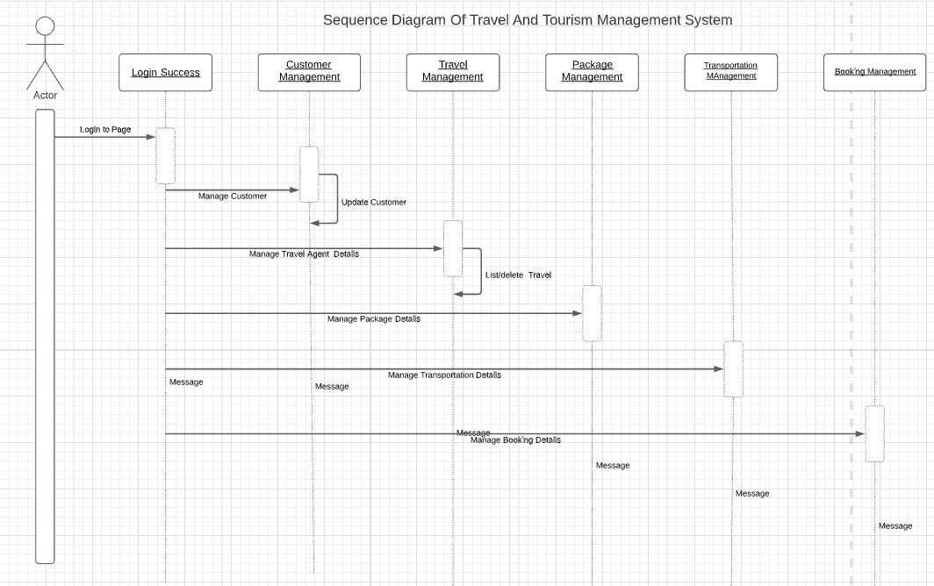
SEQUENCE DIAGRAM

Slide 18
SCREENS
Home Page
Registration Page
Login Page
Gallery Page
Package Page
About Page
Contact Page

Slide 19
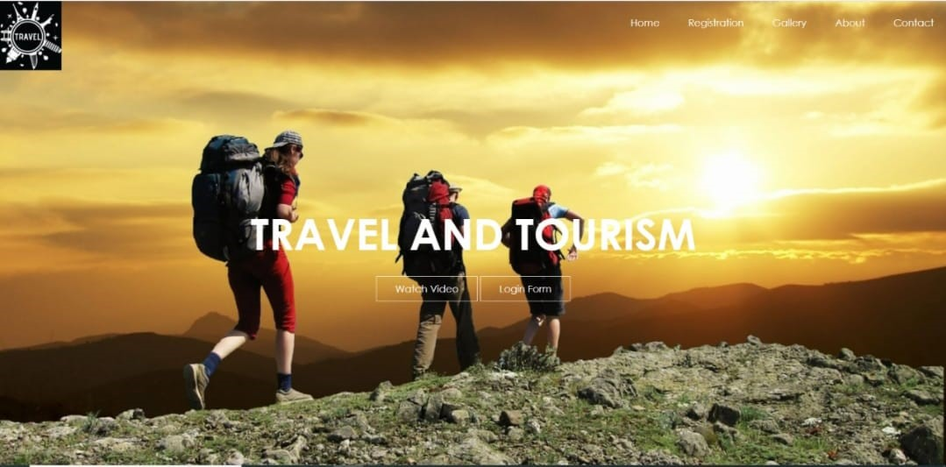
Home Page

Slide 20
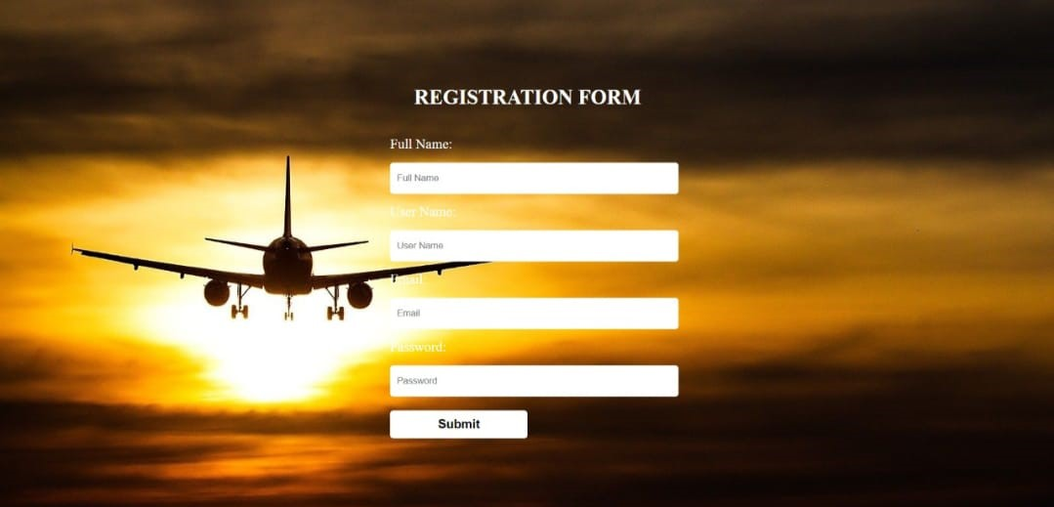
Registration Page

Slide 21
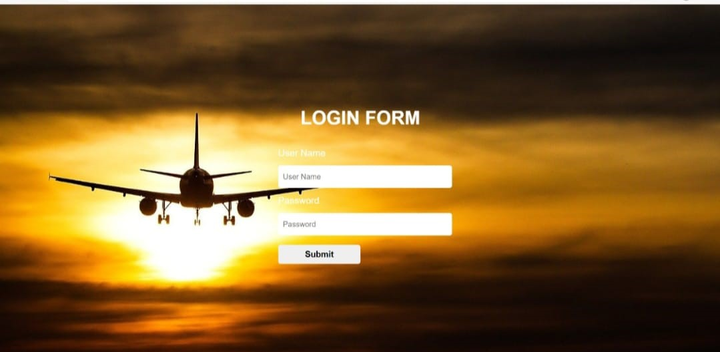
Login Page

Slide 22
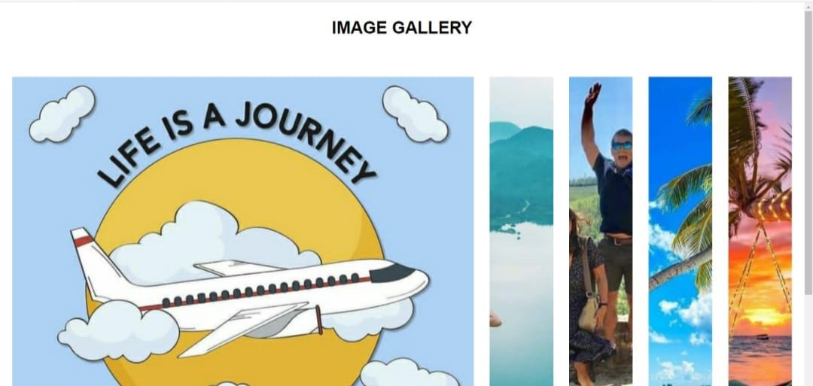
Gallery Page

Slide 23
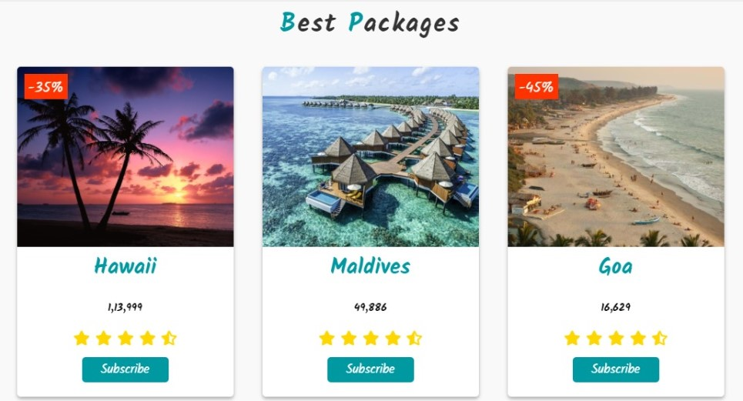
PACKAGE PAGE

Slide 24
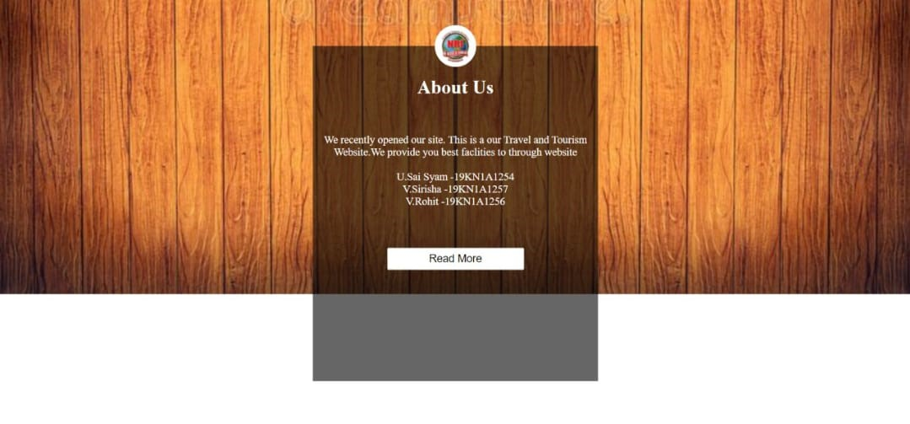
About Page

Slide 25
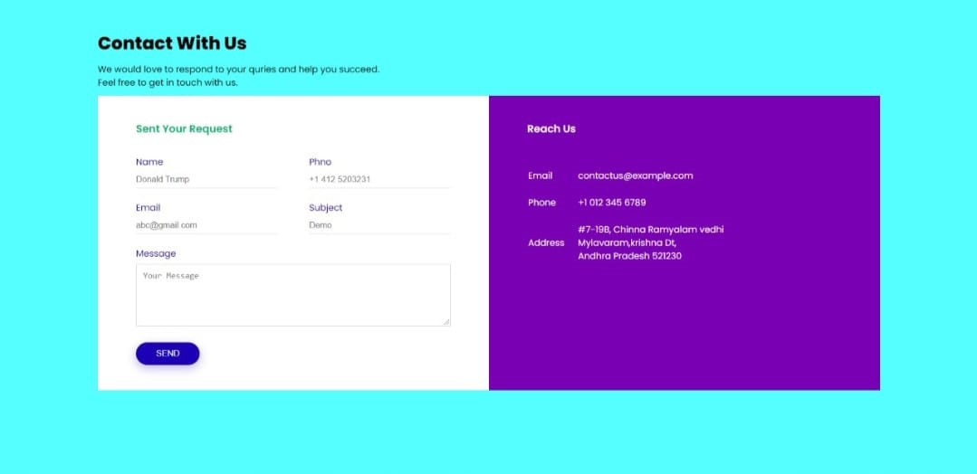
Contact Page

Slide 26
CONCLUSION
This web application was successfully created and stored all the travel admin tourism package booking creating and managing tour details into the database using this application. The application was tested very well and the errors were properly debugged. Testing concluded that the performance of the system is satisfactory. All the necessary output is generated. This system provides an easy way to automate all the functionalities of consumption. If this application is implemented in few consumptions, it will be helpful. Further enhancements can be made to the project, so that the website works in a very attractive and useful manner than the present one. It is concluded that the application works well and satisfy the needs. It also acts as the sharing of files to the valuable resources.

Slide 27


